Slide 1

On-Road
Assistance
Team Members
Rahul Kumar Dubey
Jatinder Kumar Chaurasia
Aarti Verma
Sameer Chandwaskar
Project Guidance
Mr.Nilesh Gandhe

Slide 2
What is On-Road Assistance
With new vehicular addition to the roads each day, the traffic density has been creeping significantly .
This causes more dependence on roadside assistance in situation of vehicular breakdown, fuel insufficiency or accident. An app, which shall let the users to request for an on-road assistance will be a game changer to the automobile industry.
The solution developed will address the objective in a holistic manner and will have all the features and functionalities which shall let the portal allow a customer to perform a location based search, browse by the nature of service offered and contact info. This shall allow the mechanic to accept the request from the customer and a real time navigation can be performed. Customer rating for the service will be an added feature.

Slide 3
Objectives
Customer and Mechanic registration and credential authentication.
Requests for service by customer.
Location based searching of mechanics.
Accepting requests made by customer and providing service.
Real time navigation.

Slide 4
Technology & Tools
Front-End
HTML5,CSS3,Bootstrap,Javascript
Middleware
Java,JSP,Servlet
Back-End
Oracle
Tools Used
Eclipse oxygen
Visual Studio Code
SQL Developer 18.4
Apache Tomcat 8.5

Slide 5
Signup Page: User registers either as mechanic or customer
Login Page: Mechanic Login with Valid Credentials.
Login Page: Customer Login with Valid Credentials.
Mechanic
Customer
Service Page : Mechanic offer service by selecting request from a customer.
Request Page : Customer sends request for help by sending details about themselves and location.
WORKFLOW
Search Mechanics : Customer selects a mechanic based on mechanic ratings.
Real time Navigation: customer and mechanic uses real time navigation to identify the current location.
Rating :
Customer rates mechanics.

Slide 6


Slide 7
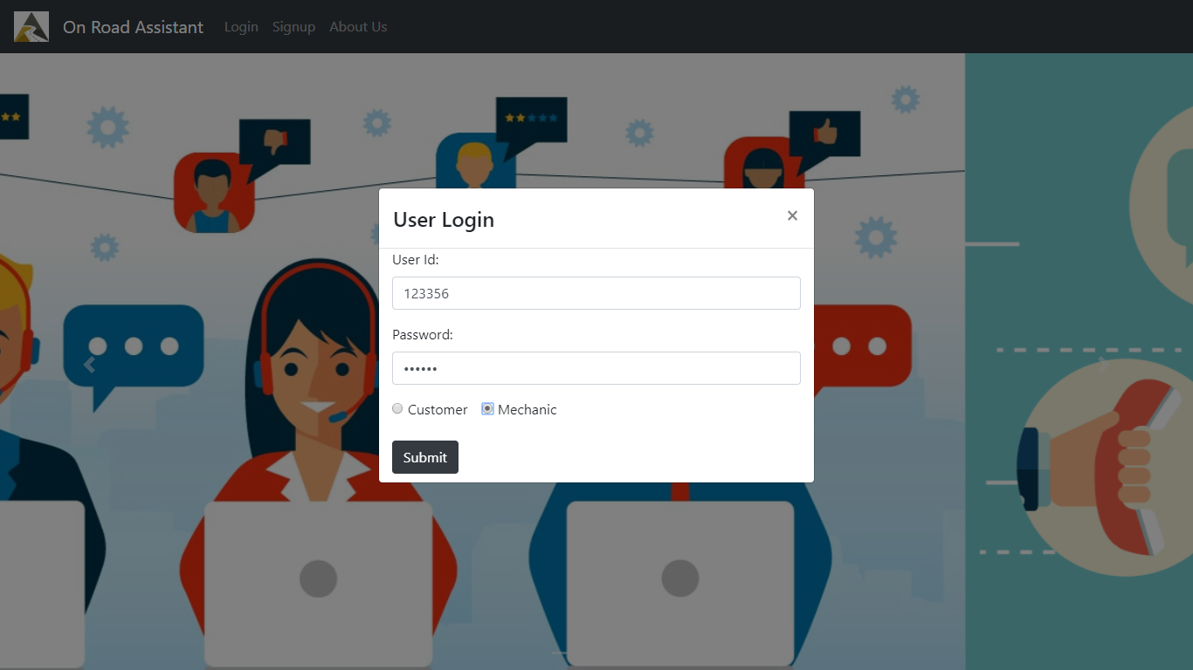

Slide 8
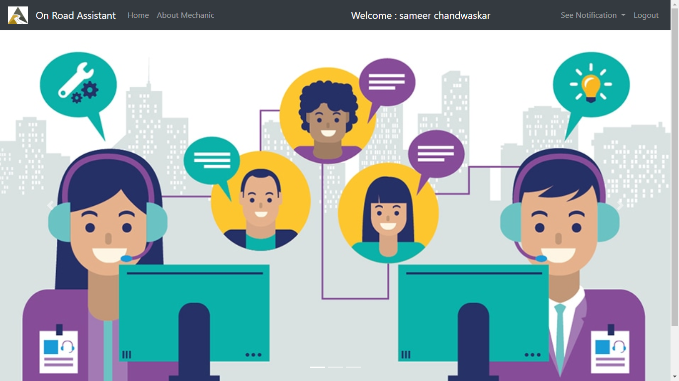

Slide 9
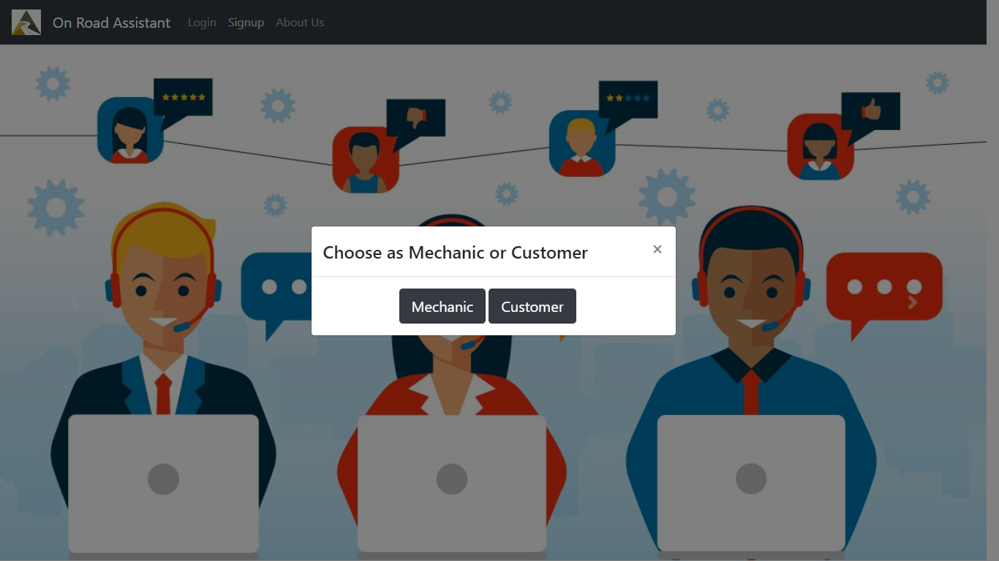

Slide 10
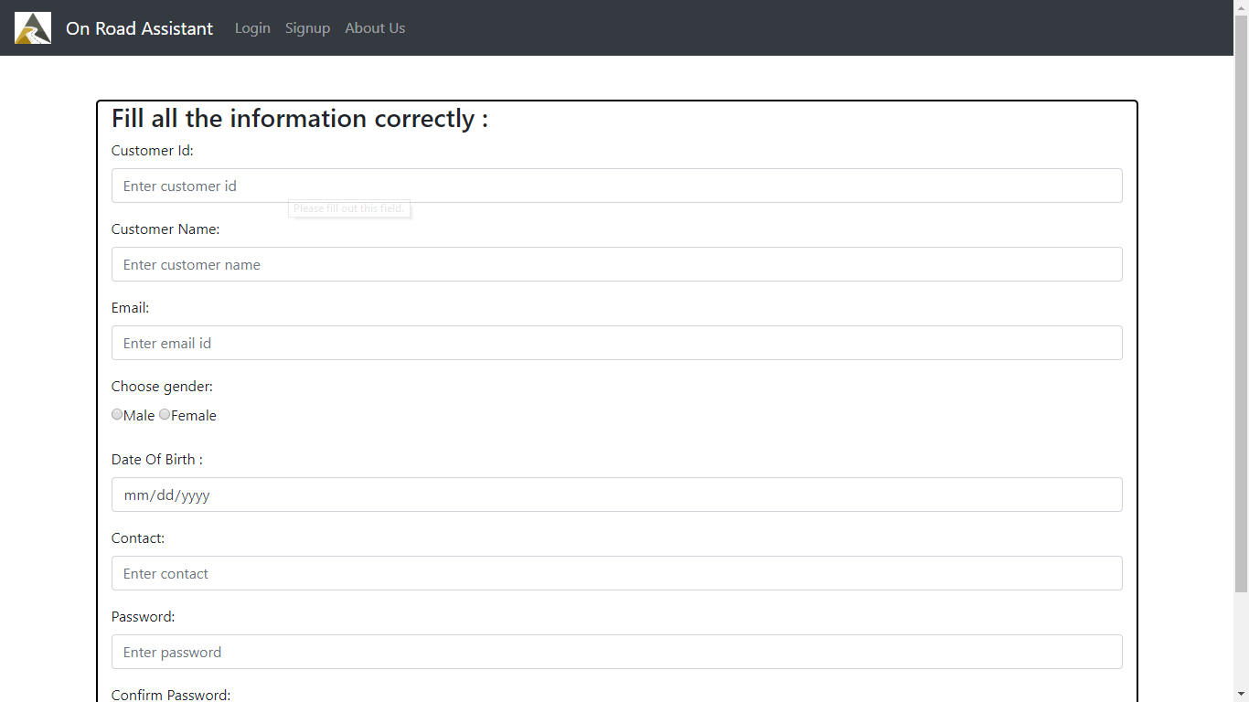

Slide 11
Future Scope
We will Integrated Angular with recent application
Analyzing UI with profiling

